Slide 1

Rural Food Processing
5 March 2020
ME 486C - Team Cocoyam
Samantha Morrison - Project Manager
Nygel des Vignes - Financial Manager
Musab Al-Balool - Manufacturing Engineer
Humoud Alanjari - Logistics Manager
Sponsored By:

Slide 2
Outline of Presentation
5 March 2020
Project Description
Design Description and CAD
Current State of System
Implementation/Manufacturing Plan
Testing Plan
Future Work
Rural Food Processing
Al-Balool 2

Slide 3
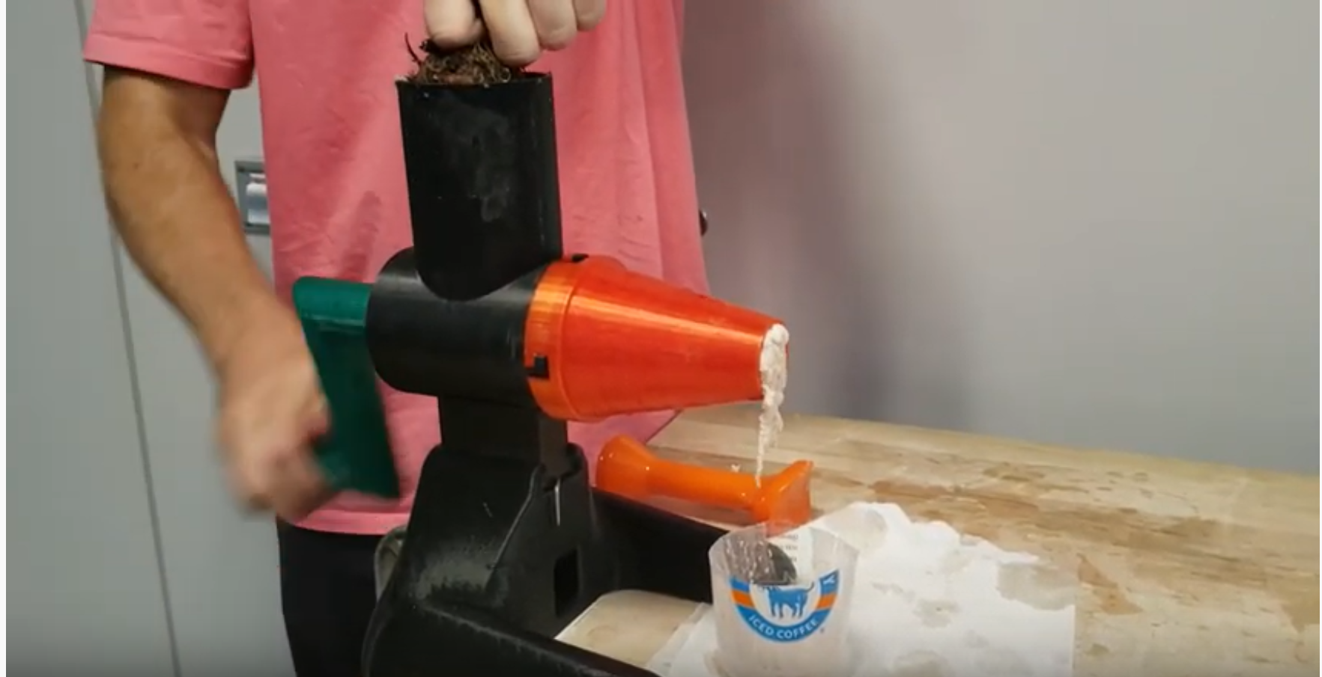
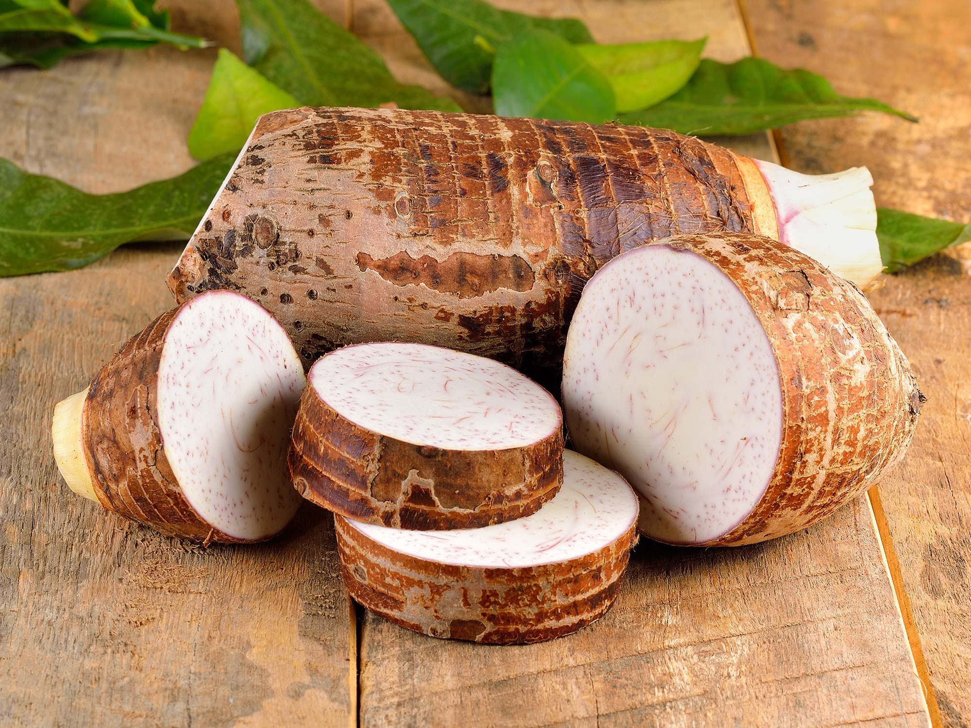
Project Description
5 March 2020
Cocoyam dispenser and roller
Improve upon current hand rolling technique
Help West and Central African Communities
Continue upon Georgia Tech’s grinder
Create a design package that can be transferred and replicated easily
  Includes descriptive assembly manual
Client- Isaac Zama - Humanitarian
Mentor - Chuck Vallance
Sponsor - W.L. Gore
Figure 1: Manual grinder by Georgia Tech [1]
Figure 2: Raw Cocoyam [2]
Rural Food Processing
Al-Balool 3

Slide 4
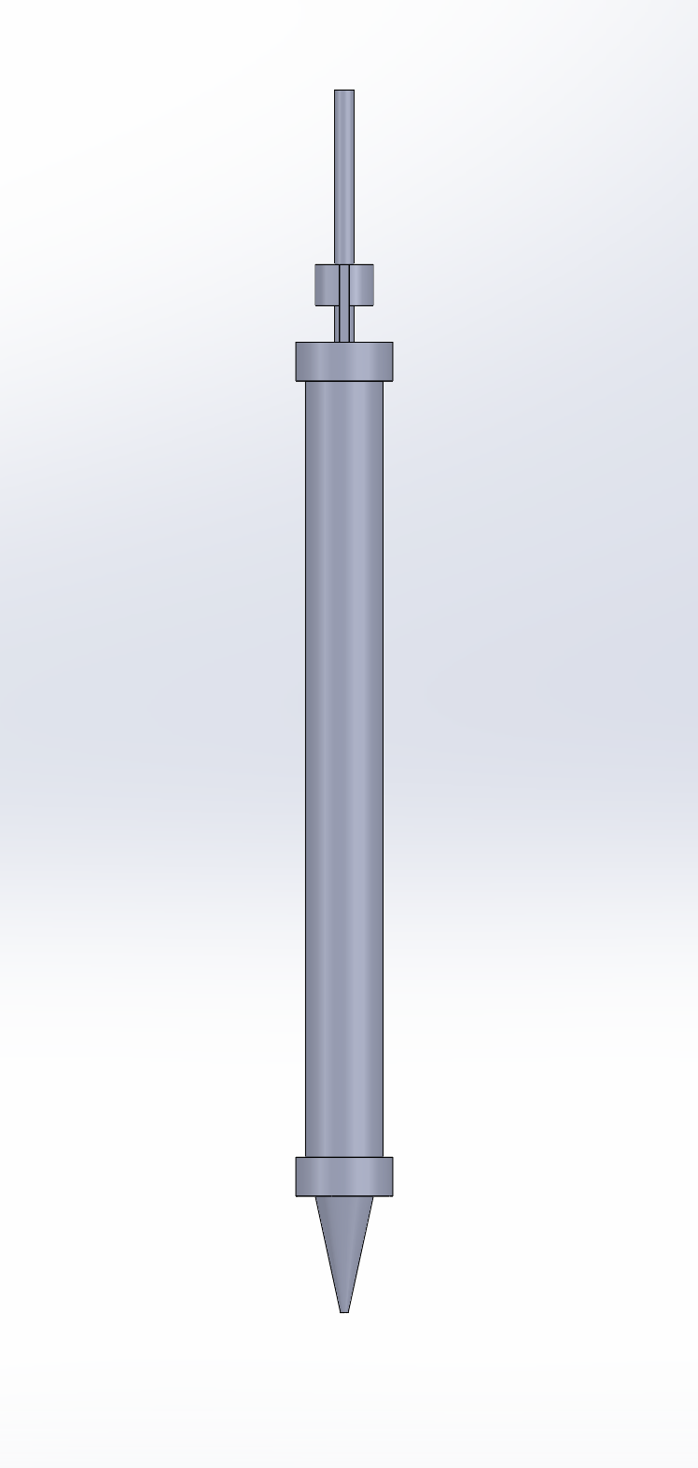
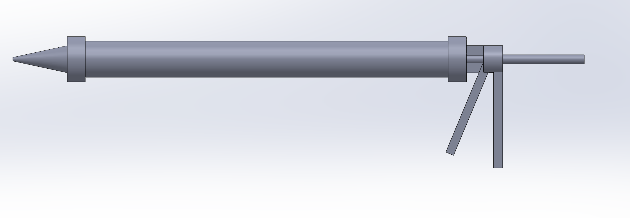
Design Description - Dispenser CAD
5 March 2020
System is bought commercial off-the-shelf
CAD is for general visualization purposes
Figure 3: Updated CAD Side View
Figure 4: Updated CAD Top View
Rural Food Processing
Morrison 4

Slide 5
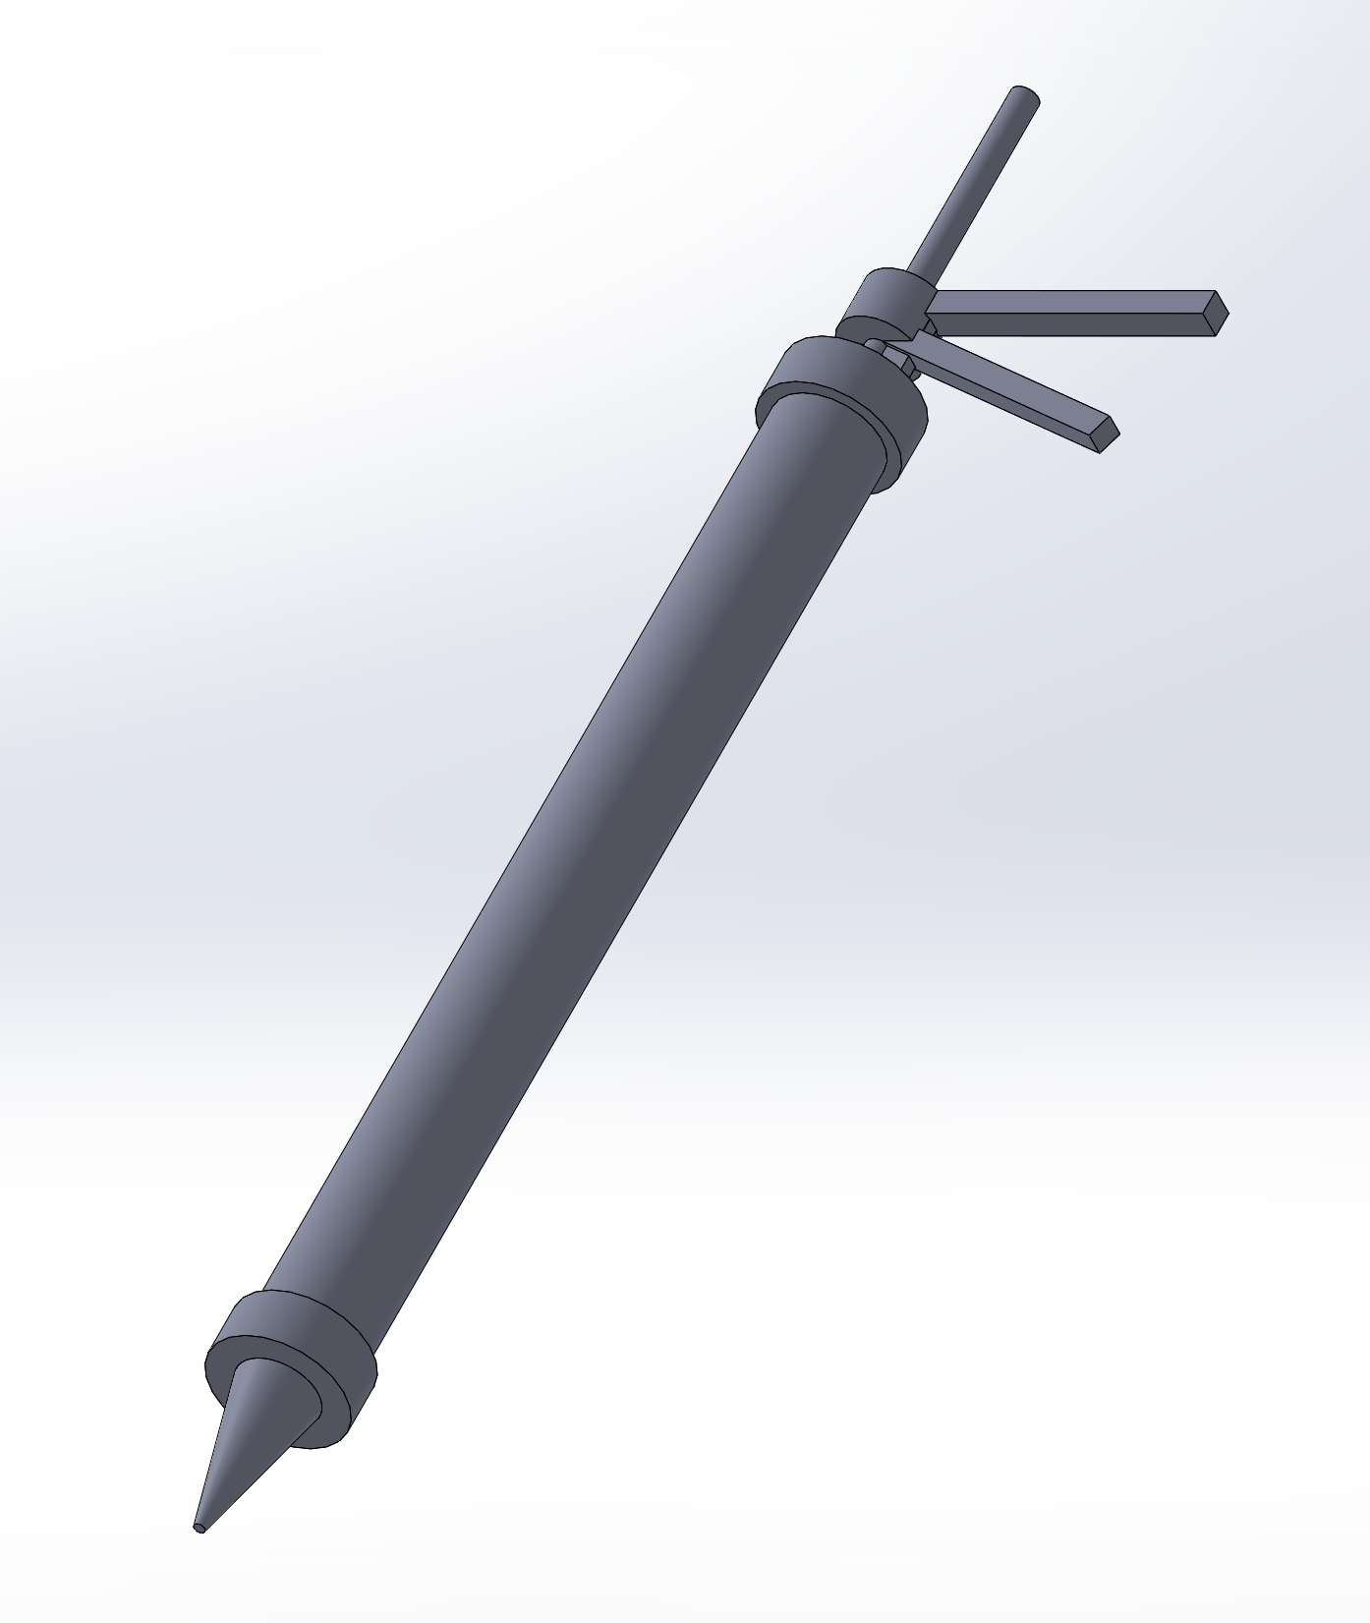
Design Description - Dispenser CAD
5 March 2020
(1)
How Subsystem Functions:
  Back end is pulled outward to open central cavity (1)
  User unscrews front end (2)
  User fills central cavity with cocoyam mixture with desired amount (3)
  User screws front end back on with tip still in place (4)
  User pumps handle to progress back end until cocoyam begins extruding from tip (5)
(5)
(3)
(2)
(4)
Figure 5: Isometric view with numbered indicators
Rural Food Processing
Morrison 5

Slide 6
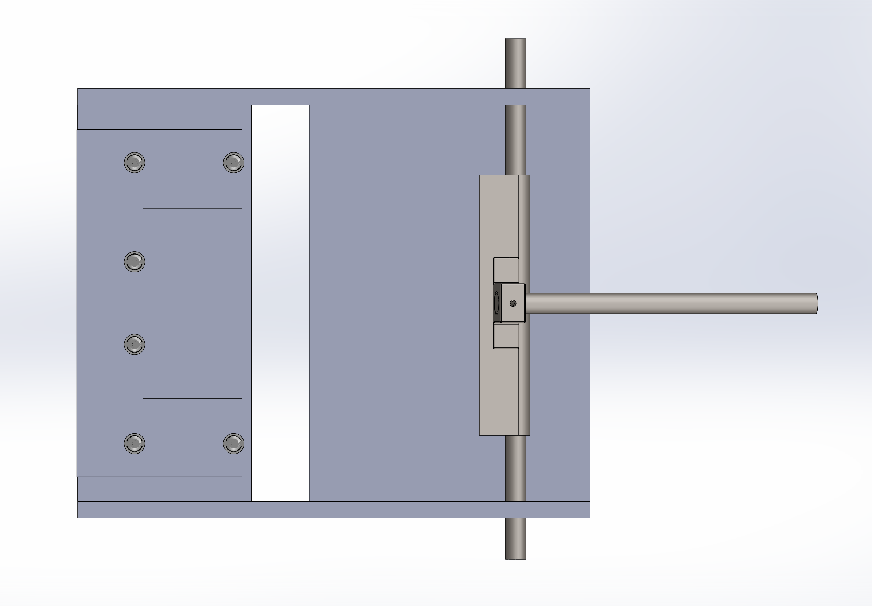
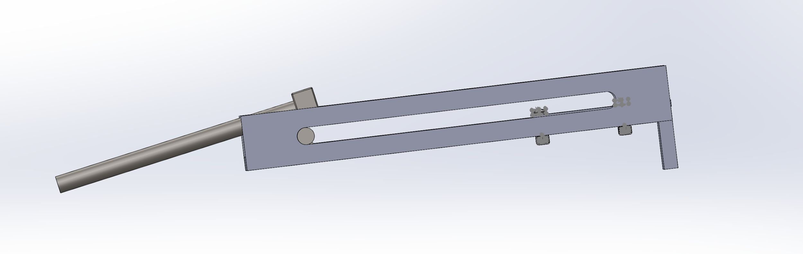
Design Description - Roller CAD
5 March 2020
Reuse of previous iteration in silver
New components in gray
  Fasteners also changed
Figure 6: Updated CAD Top View
Figure 7: Updated CAD Side View
Rural Food Processing
Morrison 6

Slide 7
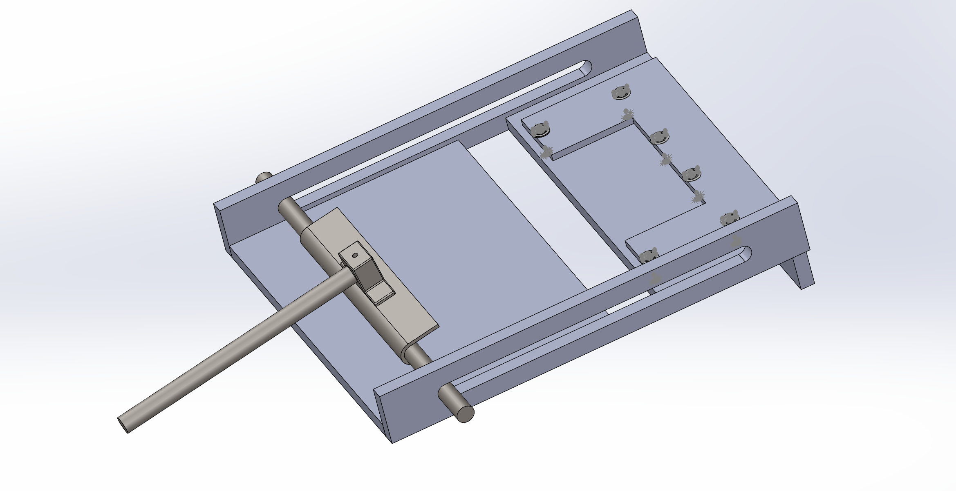
Design Description - Roller CAD
5 March 2020
(3)
How Subsystem Functions:
  Cocoyam and leaf placed (1)
  User holds handle (2)
  User pushes handle to end of rail (3)
  Cocoyam is rolled and deposited into crevice in base plate (4)
  User pulls handle to start of rail (5)
  User removes rolled Ekwang
(4)
(5)
(1)
(2)
Figure 8: Isometric view with numbered indicators
Rural Food Processing
Morrison 7

Slide 8
Full System CAD
5 March 2020
How System Functions:
  User uses dispenser subsystem to dispense desired amount onto prepared cocoyam leaf
  User uses roller subsystem to roll prepared leaf into dish
  Repeat until desired amount of rolls have been accomplished
Figure 9: Entire system (both subsystems together)
Rural Food Processing
Morrison 8

Slide 9
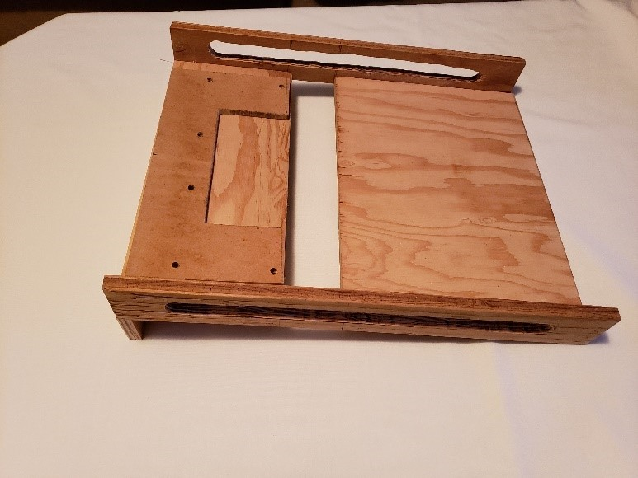
Current State of System - Current Manufacturing
5 March 2020
Latest version made of wood per customer’s request
Need to refine rails and seal wood to prevent water damage
Handle will be 3D printed or made from metal
Figure 10: Wood Prototype
Des Vignes 9

Slide 10
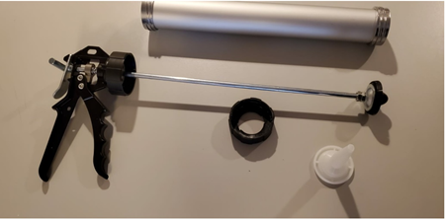
Current State of System - Current Manufacturing
5 March 2020
Dispenser need has been determined to be fulfilled through commercial off-the-shelf product
12:1 mechanical advantage
Easy disassembly for cleaning and refilling
Exploring additional alternatives at different mechanical advantages and price points
Figure 11: Dispenser Prototype
Des Vignes 10

Slide 11
Current state of system-ER
5 March 2020
ERs:
  Low cost< 45 dollars
  Minimize the time to produce one role<30 seconds
  Light weight [kg] <7kg
  Base footprint area [m²] < 0.125m²
  Smooth edges [mm] radius<5mm
  Low center of gravity
  Factor of safety >3
Values Achieved by Design
Mass of the system - 7.22kg
Base footprint area - 0.12m²
Radius of edges - 1mm
Center of gravity at (0.105,0.216,0.335)mm
Force to push handle - 2.44lbs
Rural Food Processing
Des Vignes 11

Slide 12
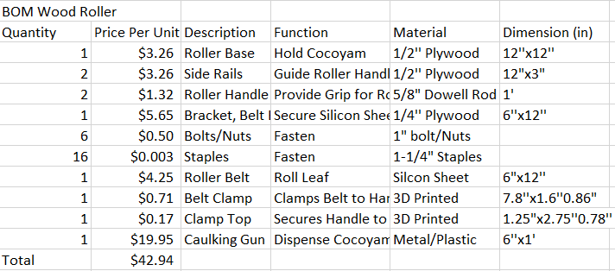
Current State of System - BOM/Budget/Purchasing
5 March 2020
Table 1: Bill of Materials
Budget
Total budget of $1500 from Gore
Currently have $1166.72 remaining
Prototyping has been main expense at $333.28
Future Cost
Viscosity testing $145.54 +$43.60/hr (approximately 2hrs)
Travel expenses
Cocoyam mixture/Roll materials
Des Vignes 12

Slide 13
Current State of System - Action Items
5 March 2020
Update CAD package to include wood roller -Samantha
Build wood prototype-Nygel
Secure testing materials- Humoud
Manufacture prototype -Musab
Redesign dispenser- Team
Find Cocoyam substitute for testing-Team
Des Vignes 13

Slide 14
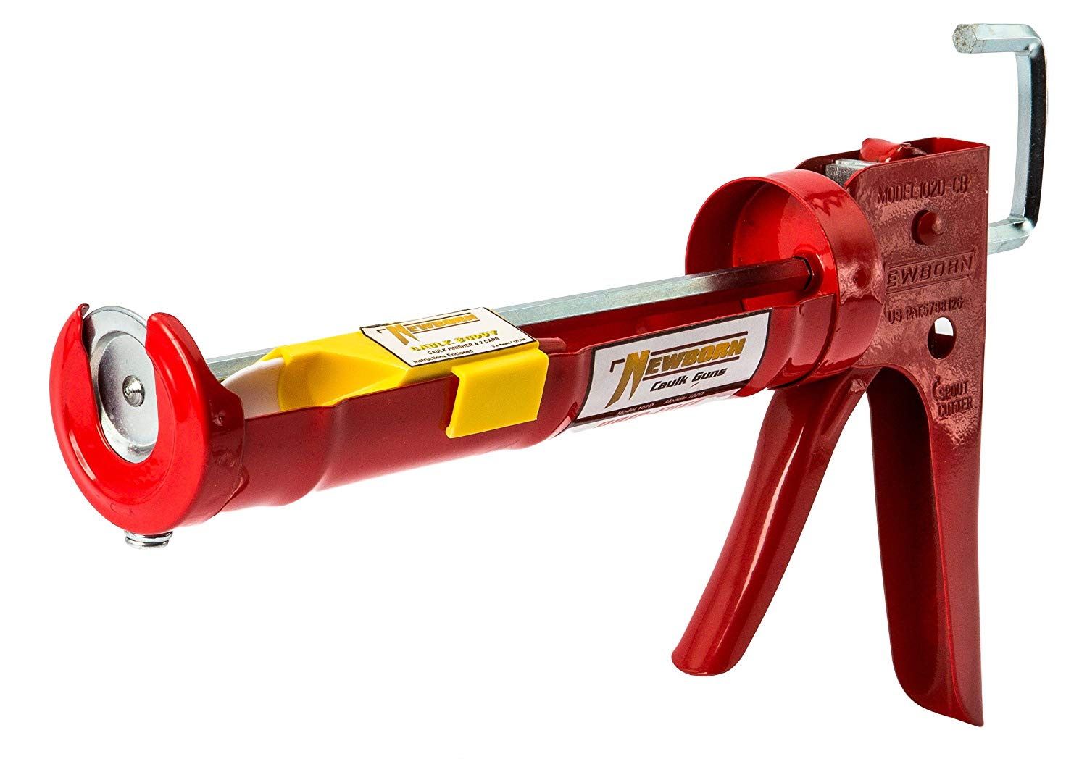
Implementation Plan - Future Manufacturing of Final Product
5 March 2020
Need to refine rails and seal wood to prevent water damage.
Replacing the dowel rod handle to C-shaped handle that will sit above the roller bar.
Handle will be either 3D printed or made straight from metal.
New caulking gun for our dispenser system.
Palm oil for adding wood protection.
Figure 12: Smooth hex rod cradle caulking gun [3]
Al-Balool 14

Slide 15
Implementation/Manufacturing Plan - Future Action Items
5 March 2020
The final product will be manufactured and assembled in the same manner as the wooden prototype with greater attention to detail - goal is to produce a final product that anyone can make, so we will not be outsourcing manufacturing with the exception of purchasing the caulking gun
Future Action Items:
Updating CAD package to include new dispenser and all drawings - Samantha
Fixing the wooden prototype - Nygel
Building the C- shaped handle - Musab, Samantha
Testing the new caulking gun option - Humoud
Testing procedure - Team
Poster presentation - Team
Creating operation manual - Team
Creating assembly manual - Team
Al-Balool 15

Slide 16
Testing Plan Test 1 and 2
5 March 2020
Table 2: Test 1 - Roll Production Time
Resources | Description | Obtain Resource
People | Volunteers varying in age | Free, voluntary participants
Timer | Stopwatch to measure time to roll | Free, phone timer
Cocoyam Paste | Grated cocoyam and spice mixture | Buy, specialty market
Device | Device completely assembled | Buy, the final product
Location | Any available space | Free, public space
Table 2: Test 2 - Drop Test
Resources | Description | Obtain Resource
People | Team Members | Free, self
Countertop | Approximately one meter high | Free, at home/98C
Device | Device completely assembled | Buy, the final product
Location | Any available space | Free, public space
Rural Food Processing
Alanjari 16

Slide 17
Testing Plan Test 3 and 4
5 March 2020
Table 3: Test 3 - Stability Test
Resources | Description | Obtain Resource
People | Team Members | Free, self
Pull Gauge | Gauge that can measure at least 10kg | Borrow, from professor
Device | Device completely assembled | Buy, the final product
Location | Any available space | Free, public space
Table 2: Test 4 - Analysis Software Test (Bolt factor of safety and center of gravity)
Resources | Description | Obtain Resource
People | Team Members | Free, self
Software | SolidWorks | Free, access on NAU computers/VPN
Software | Excel for factor of safety, BOM | Free, access form Microsoft Excel
Device | SolidWorks Model | Free, created on NAU purchased software
Location | Any available space | Free, EGR building/anywhere on VPN
Rural Food Processing
Alanjari 17

Slide 18
Testing Plan Test 5 and 6
5 March 2020
Table 5: Test 5 - Smooth Edges
Resources | Description | Obtain Resource
People | Team Members | Free, self
Balloon | Party balloon style | Buy, local store/Free, leftover from member
Device | Device disassembled to test surfaces | Buy, the final product components
Location | Any available space | Free, at home/98C
Table 6: Test 6 - Dimension Test
Resources | Description | Obtain Resource
People | Team Members | Free, self
Software | SolidWorks | Free, access on NAU computers/VPN
Device | SolidWorks Model | Free, created on NAU purchased software
Scale | Basic scale | Free, member has resource
Ruler | Basic meter stick | Free
Location | Any available space | Free, EGR building
Rural Food Processing
Alanjari 18

Slide 19
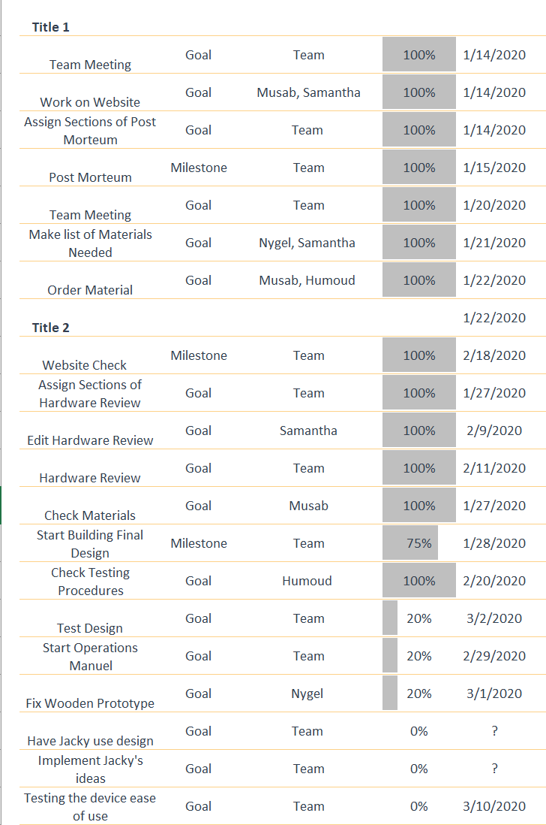
Future Work
5 March 2020
^{Handle redesign}
^{Finish CAD drawings}
^{Smoothing railways edges}
^{Assembly and Operations Manual}
^{Testing}
Figure 12: Gantt chart for Spring semester
Rural Food Processing
Alanjari 19

Slide 20
Questions?
5 March 2020
Rural Food Processing
20

Slide 21
Citations
5 March 2020
[1] Evan Williamson, “Coco-YUM! - The manual cocoyam processor,” YouTube, 23-Jul-2019. [Online]. Available: https://www.youtube.com/watch?v=siXvcSSyxC4#action=share. [Accessed: 15-Sep-2019].
[2] Admin, “Health Benefits and Nutrition of Taro Root,” TAROTO TAIWANESE HEALTHY DESSERT. [Online]. Available: https://tarotodessert.com/en/2017/health-benefits-and-nutrition-of-taro-root/. [Accessed: 17-Sep-2019].
[3] Amazon.com, 2020. [Online]. Available: https://www.amazon.com/Newborn-102D-Drip-Free-Caulking-Cartridge/dp/B002YC3W48/ref=sr_1_4?crid=ZQQQS3YQJUM6&keywords=caulking+gun&qid=1582929240&sprefix=caul%2Caps%2C226&sr=8-4. [Accessed: 05- Mar- 2020].
Rural Food Processing
21

